Slide 1
Convolutional Encoding
Constraint Length 3
Rate ½
(2,1,4) Code
Tap patterns 1_7 and 1_5 (octal)

Slide 3
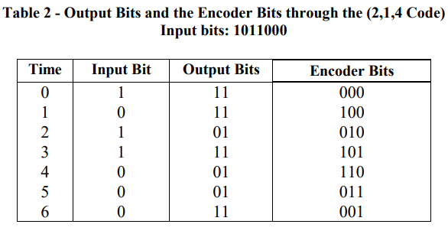
Input -> Output and Internal State
Start at encoder state 000

Slide 4
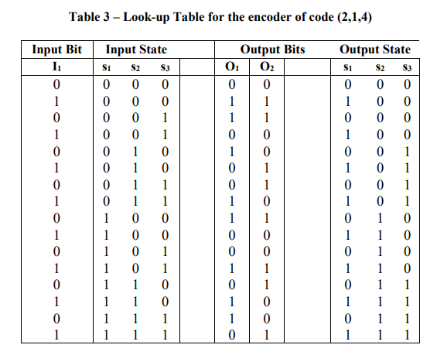
LFSR transitions – constraint length 3
Input Bit, State
➔
Output Bit, State
(1)7, (1)5 (octal)

Slide 5
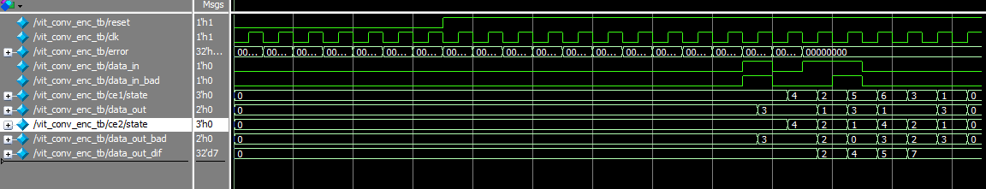
Error Injection and Path Metric
Test runs two convolutional encoders in parallel. One is given a bad input bit, and data_out_dif keeps a running sum of Hamming deviations between the correct encoder's and the bad encoder's output streams.

Slide 6
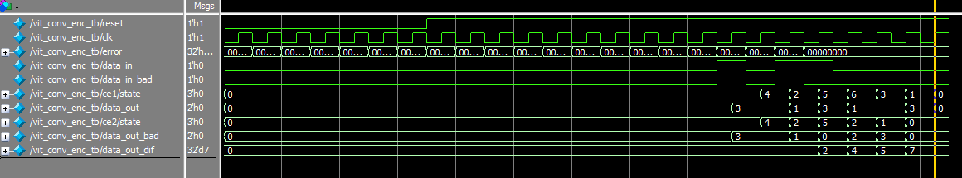
Delay error inject
Error injection delayed by 1 clock from before
Path metric deviation again = 7, not delayed start of count

